Slide 1
Employee Reload Options
Paper by:
Philip H. Dybvig, Washington University
Mark Loewenstein, Boston University
Presented by:
K. Joseph Carroll

Slide 2
Content
What Is A Reload Option?
Background
Assumptions and Set Up
The Model
Discrete Exercise
Continuous Exercise
Black Scholes and Dividends
Time Vesting
Conclusion and Opinion

Slide 3
1. What Is A Reload Option?
An exotic derivative
Essentially an American call option with a bonus for the holder
Popular use in executive compensation
Performance incentive, promotes executive ownership of the company

Slide 4
Basic Reload Process
Holder excercises the options before maturity date
Holder pays strike price with previously owned shares
For every option exercised, the holder receives one new share
For every share tendered to pay the strike, the holder receives a reload option

Slide 5
Reload Option Example
Bob owns 100 reload options with strike K = $100, A $10,000 gross strike.
Bob exercises his options before maturity at S = $125.
Bob must pay the $10,000 strike price with K/S = 80 shares. (80x$125=$10,000)
Every exercise grants a new share. Bob’s exercise grants him 100 new shares - 80 (pre-existing) tendered for strike price = 20 new shares of stock with market value $125*20=$2,500.
Bob is also granted 80 new options (one for each share tendered for K) with new strike $125 and same maturity as the original options. This is the “reload.”

Slide 6
Variations and Conventions of Reloads
Most common: unlimited, uninhibited reloads
Some plans have unlimited reloads but with six month waiting period between exercises
Variations on amount of reloads
Some plans issue enough reloads to cover tax on strike price
Some plans issue reloads to replace ALL options exercised
We focus on unlimited, uninhibited reloads with one reload per share tendered as with Bob.

Slide 7
2. Background
Reload options are relatively young, created in 1987
Controversy has surrounded reload options from ignorance:
Ability to exercise again and again is a “money pump”
Companies “lose control of number of shares issued”
Reloads create bad incentives for executives to take big risks to compensate
However:
1. value of the reload option is bounded above and below by stock price and American call price
2. The net number of new shares issued is bounded by the initial count of reload options
3. The incentives from reloads are not much different than that of a European call

Slide 8
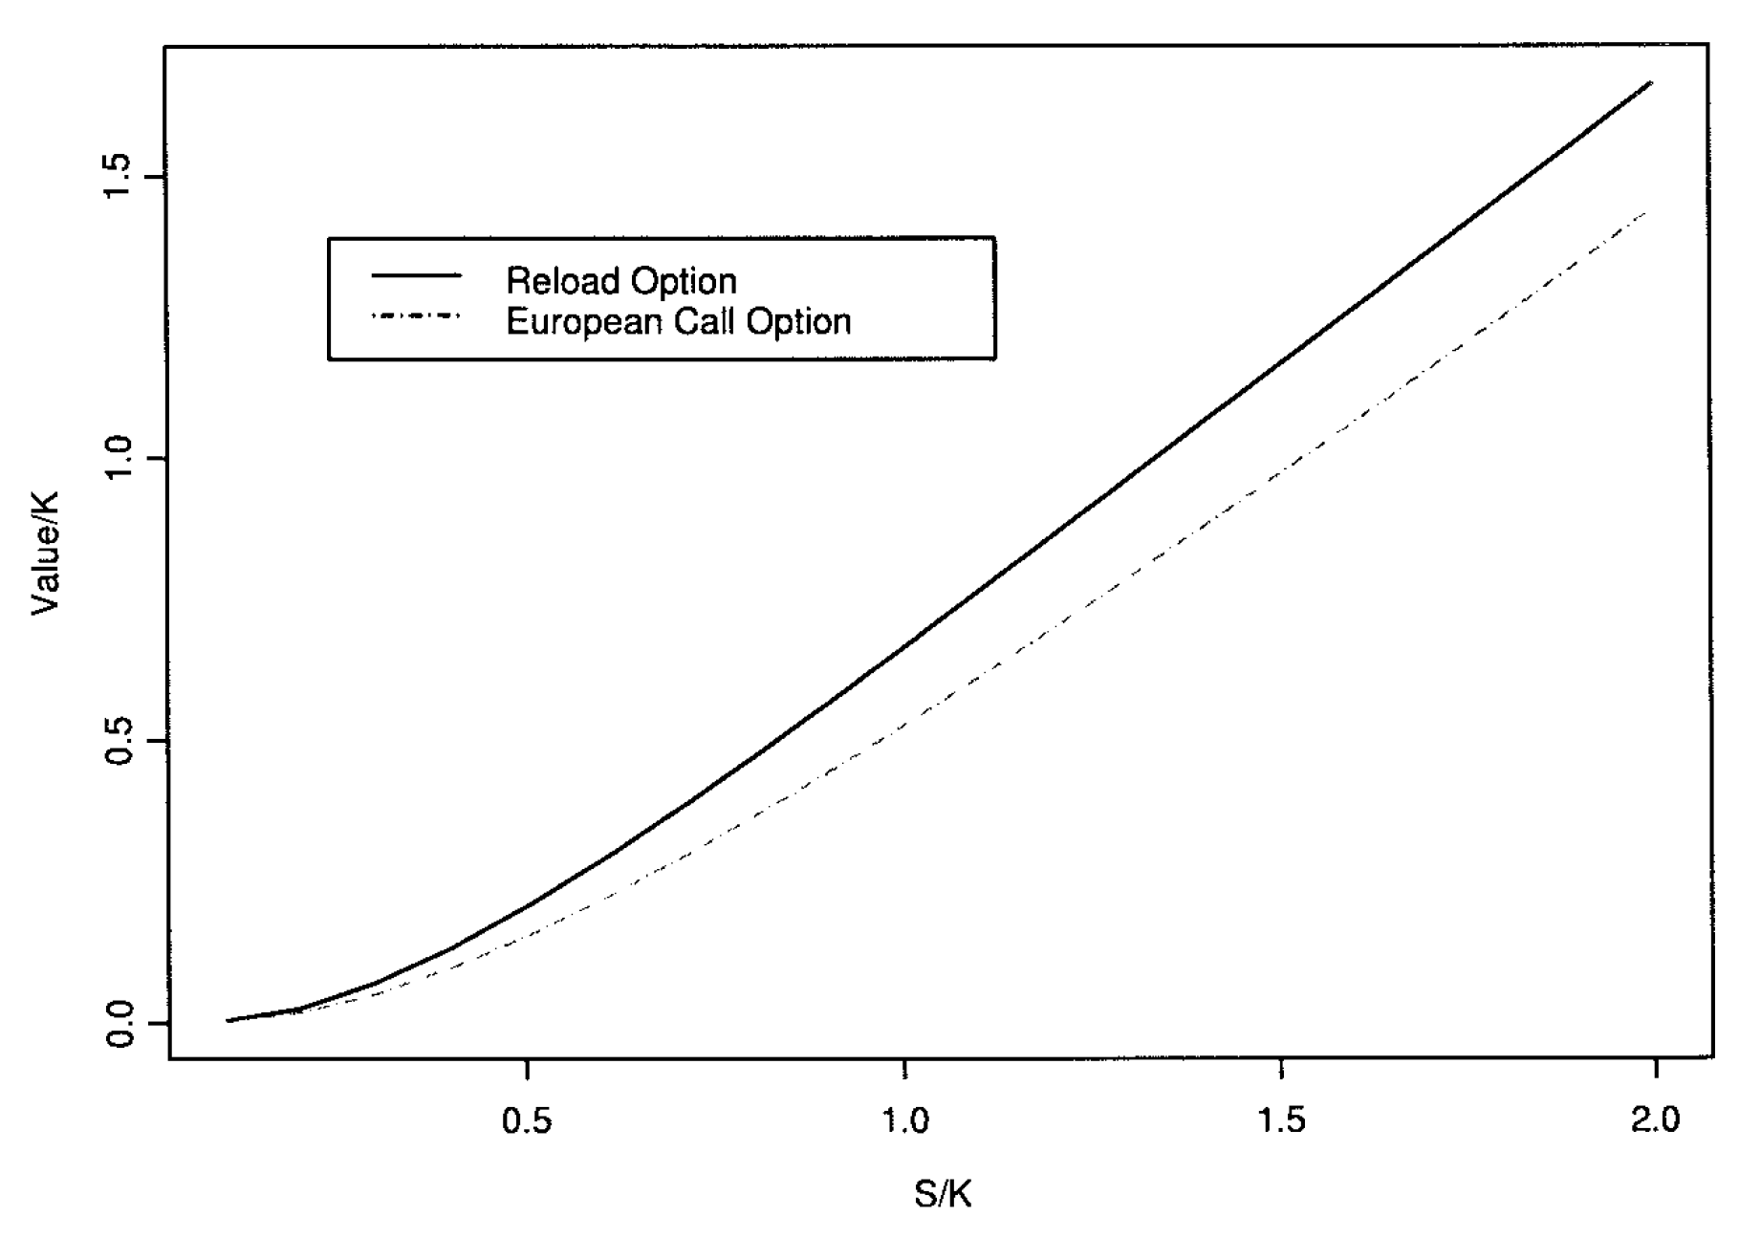
Reload vs. Euro Call
Although Reloads are more valuable, the curve is very similar to a European call under BS assumptions
(Further out of money = more valuable)
Similar incentive effects to a typical option; reloads aren’t so dangerous after all?

Slide 9
3. Assumptions and Set Up
Employee can retain new shares from exercise
Employee either owns or can borrow enough shares to pay the exercise price
Stock price and compensation are unaffected by exercise
No transaction cost or taxes
Non-negative dividend payments, stock strictly positive, prefer consumption
The value of a reload option conveniently bounded:
Bounded above by the stock price
Bounded below by the corresponding American call

Slide 10
4. The Model
Two primitive assets
“the bond” – locally riskless
“the stock” – risky asset
S(t), the risky asset, may pay dividends and thus can only jump down
alpha(t)=number bonds held, B(t) = bond process, theta(t) = number stocks held, S(t) = stock process, C(t) = cash flow, D(t) > 0 = cumulative dividend per share. W(t) is the nonnegative wealth process

Slide 11
5. The Discrete Exercise of The Option
Assumption in this case: The holder has enough shares to pay the initial price, can retain the shares on exercise
Payoff at time t<=T is 1-K/S(t) shares, plus K/S(t) reload options
In this framework, we assume there are discrete times where exercise is available.

Slide 12
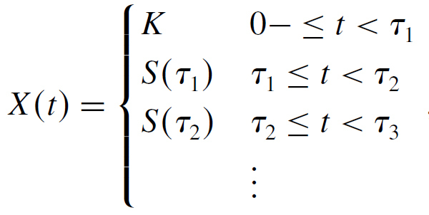
Multiple Exercises
First exercise: shares and reload options with strike
Second exercise: share, and in total
share and reload options
General form: shares and reload options.

Slide 13
Theorem 1
It is optimal to exercise the reload option whenever it is in the money, and not when it is out of the money.
Exercise process:
or the maximum of the strike and the highest stock price in the life of the option

Slide 14
6. Valuation of Reload Options, Continuous Exercise
Black Scholes Derivation ->

Slide 15
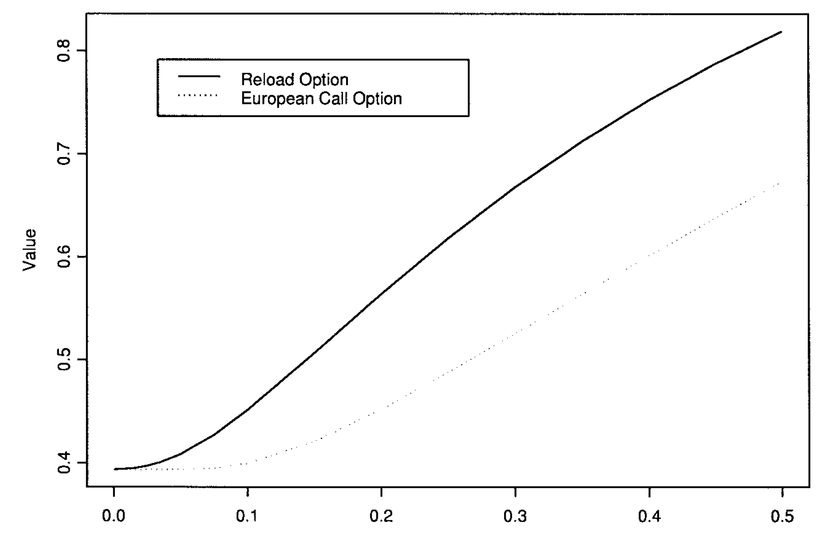
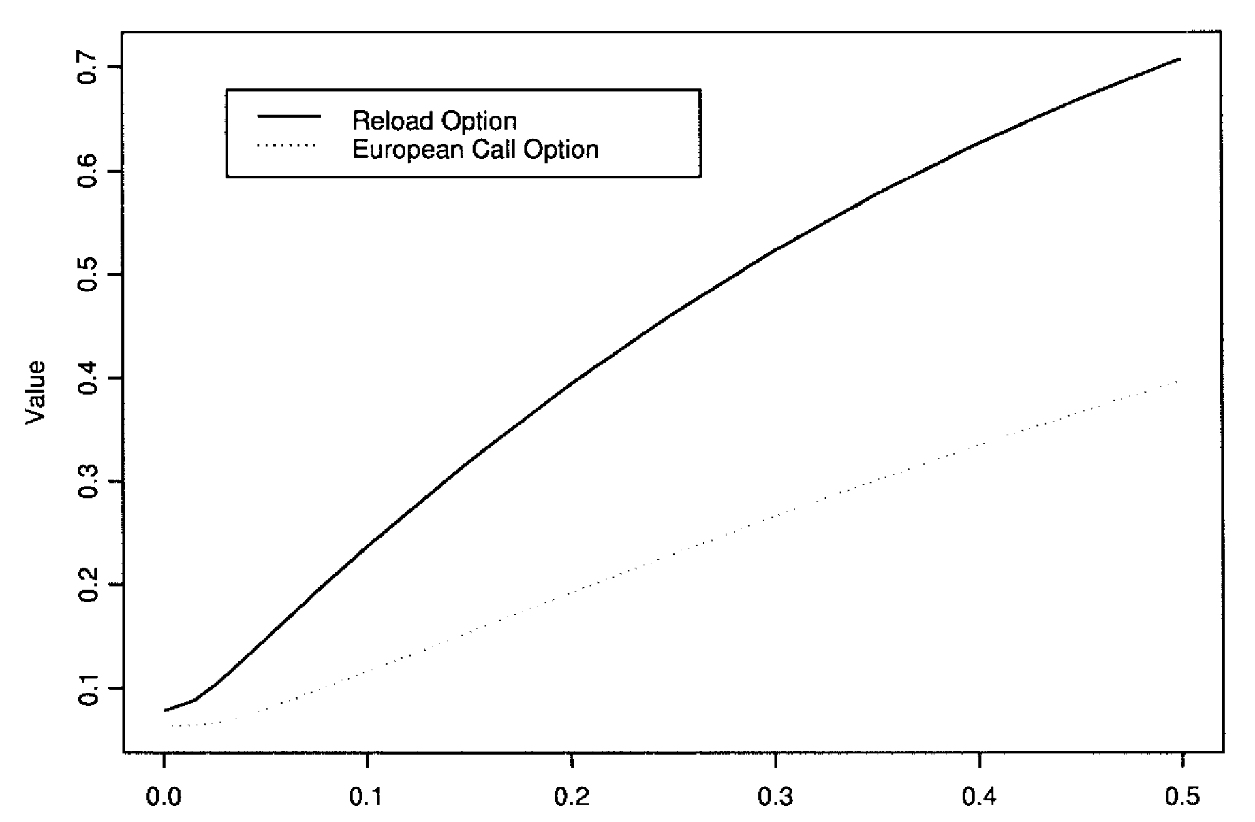
7. Black Scholes Case With/Without Dividends
“A share grant and a European call option”
Value comparison of Euro Call to Reload with no dividends (Left) and with Dividends (Right). Note the larger gap

Slide 16
Similarities to Standard Calls
In Black-Scholes, like the American call, a reload option’s value is:
Decreasing in strike
Increasing in stock price
Increasing in maturity
Decreasing in dividend rate
Increasing with volatility/risk

Slide 17
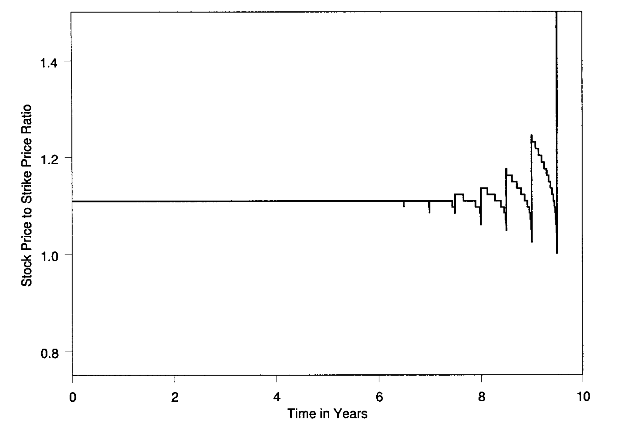
8. Time Vesting
Exercise is most attractive
at later dates when there is
a multiple of the vesting
period (typically 6 mo) left
in the option’s life, thus early
Exercise boundary is flatter

Slide 18
9. Conclusion/Opinion
It is very important to understand the true valuation of exotic derivatives
Executive compensation is heavily reliant on stock options
Anger and skepticism on exotic derivatives, especially some executive options, can be lessened by identifying boundaries, valuation, and by comparing to other more accepted derivatives
Things get much more complicated when we consider taxes and transaction costs

